Slide 1
Online Shopper’s Intentions
Created by:
YOG-2 Biji Bunga Matahari
Natih Bernan
Raden Aurelius Andhika Viadinugroho
Yusuf Fajar Mukti

Slide 2
[Metadata of the dataset]
Feature | Value
Title | Online Shopper’s Intention
Description | This file consists of various Information related to customer behavior in online shopping websites. The dataset consists of feature vectors belonging to 12,330 sessions and was formed so that each session would belong to a different user in a 1-year period to avoid any tendency to a specific campaign, special day, user profile, or period.
Source | C. Okan Sakar Department of Computer Engineering, Faculty of Engineering and Natural Sciences, Bahcesehir University, 34349 Besiktas, Istanbul, Turkey Yomi Kastro Inveon Information Technologies Consultancy and Trade, 34335 Istanbul, Turke
Update Frequency | Quarterly
Tags | business, natural and pyhsical science, computer science, statistics, society, data management, universities and college, classification, data visualization, clustering, customer value

Slide 3
[Framing & Hypothesis]
We consider this Machine Learning (ML) problem as a Binary Classification with a Supervised learning method.
Our goal is to create a ML model by which user can use to identify online shoppers’ intention (to purchase or not purchase) on product given the observed characteristics and behaviors that they have displayed.
We assume the shopper’s willingness to buy can be fully explained by all of the characteristics provided in the dataset.
Accordingly, we hypothesize that the fittest ML model would include all of the known characteristics as model’s features.

Slide 4
[Preparation needed]
Ordered Steps:
Checking each column’s data type
Identify the amount of unique values within categorical variables
Handling missing values
Create binary variables for each unique values of categorical data.

Slide 5
[Techniques]
For the technique, since the dependent variable are categorical (Revenue), then the analysis that we used are classification analysis. Here we use MLP (Multilayer Perceptron) architecture using Tensorflow library on Python. For the model, we create 2 variation of MLP model as follows :
Model 1, which does not use Dropout layer
Model 2, which does use Dropout layer, with probability 0.2

Slide 6
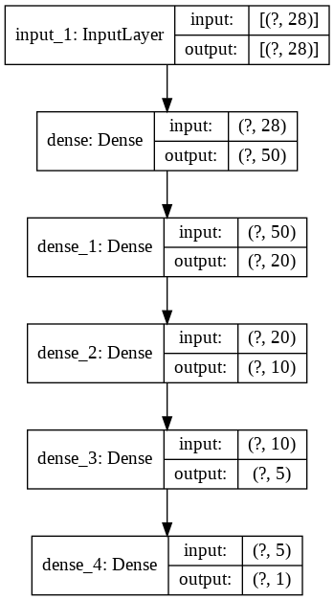
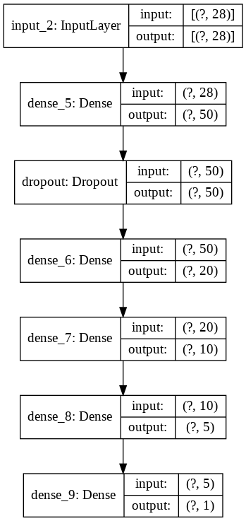
[Model Architecture]
Model 1
Model 2

Slide 7
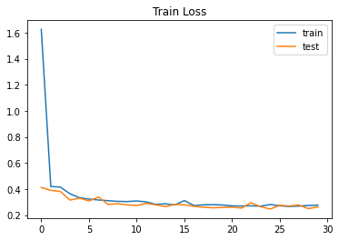
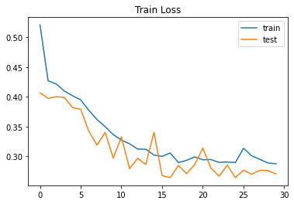
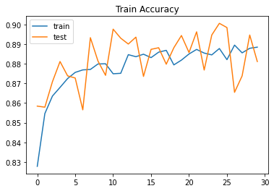
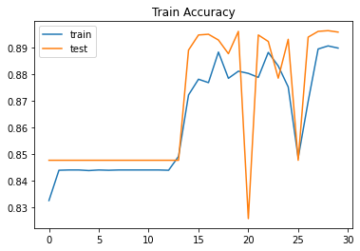
[Results]
Model 1
Model 2

Slide 8
[Results]
From the first model (Model 1), we find out that the loss value are decreasing and converges at 0.2768. For the accuracy, we can see that the accuracy on training data are 88.85% while on the test data are 88.12%.
From the second model (Model 2), we find out that the loss value are decreasing and converges at 0.2878. For the accuracy, we can see that the accuracy on training data are 88.98% while on the test data are 89.58%. Although the loss value are slightly greater than the first model, the accuracy that produced from the second model are greater than the first model, which means that this model (Model 2) performs better than Model 1.

Slide 9
[Conclusion]
From the analysis that we conducted above, we can write some conclussion below :
Most of the customers ended up did not purchase anything. Only 15.49% of the customers ended up purchasing something.
The Dropout layer on the MLP architecture (Model 2) affect the model to perform better than the model that did not use Dropout layer.

Slide 10
[Recommendation]
Then, the recommendation that we can give to the Online Shop stakeholder are follows.
We know that most of the customers ended up did not purchase anything. To increase the proportion of purchasing customers, the online shop can give some promo or discount for some products or in specific times, like Black Friday, National Online Shopping day (Harbolnas in Indonesia), Holidays, etc. And also, we also know that most of the online shop customers are the returning visitor. From the recommendation above, we can also increase the customer loyalty (and make new customers) so the revenue for the online shop can be increased.

